Slide 1
Activities of the UNECE Committee on Housing and Land Management in energy efficiency in housing
Larisa Burakova,
Housing and Land Management Unit

Slide 2
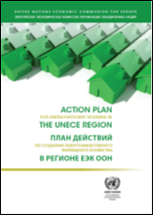
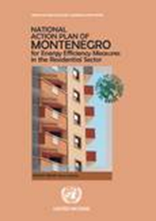
Energy efficiency steps
2009
2010
2011
2013
Green Homes
UNECE Action Plan
National Action Plan
Good practices
- Informal network of partners and experts
- Regional workshops Minsk (2011), Tbilisi (2013)
- National workshops

Slide 3
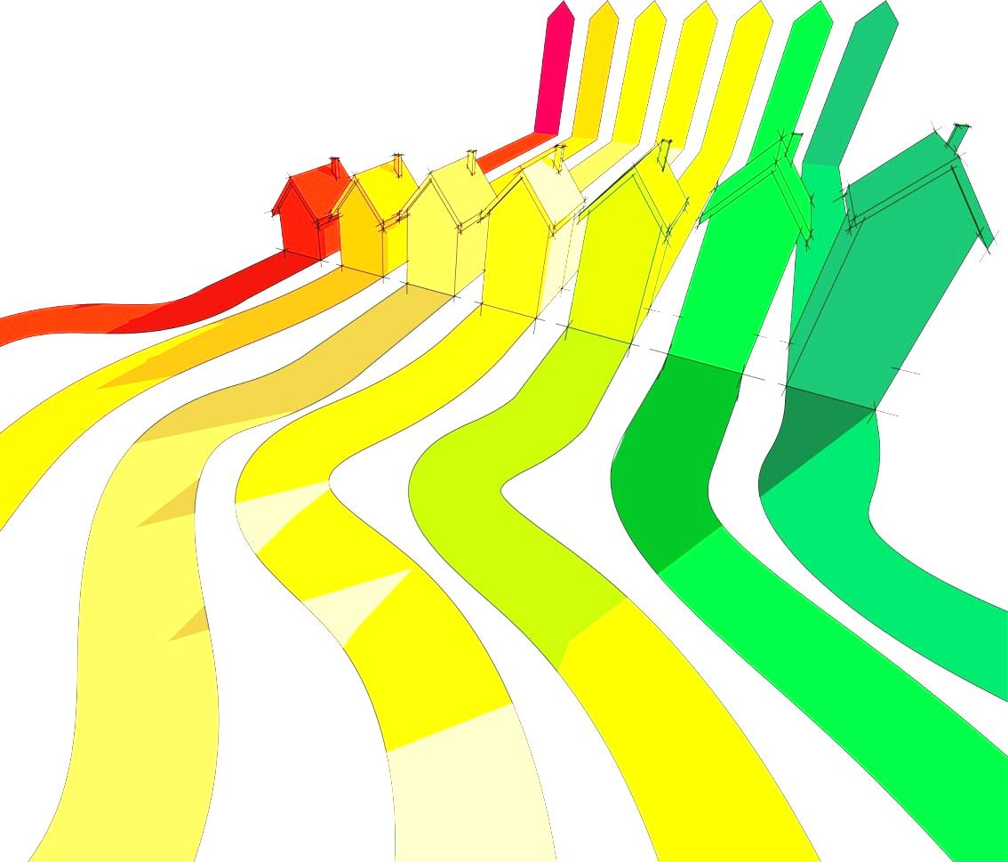
UNITED NATIONS ECONOMIC COMMISSION FOR EUROPE
UNITED NATIONS HUMAN SETTLEMENTS PROGRAMME
GOOD PRACTICES
FOR ENERGY-EFFICIENT HOUSING IN THE UNECE REGION
UNITED NATIONS

Slide 4
2
A joint effort of UNECE, UN-Habitat and the City of Vienna, this report builds on existing work in the area, such as the Action Plan for Energy-Efficient Housing in the UNECE Region issued by UNECE in 2011.
The objective of this follow-up report is to provide practical examples on means of implementation.
Examples include case studies from the UN-Habitat Best Practices Centre for Central and Eastern Europe in Vienna and case studies specifically prepared for this publication. These case studies are practical, short and illustrative, with innovative ideas presented to facilitate the exchange of good practice.

Slide 5
3
Case studies in a nutshell
Legislative framework
Energy saving and energy efficiency laws of the Russian Federation
National plan for energy transformation in Germany
Legislation framework for energy saving and energy
efficiency enhancement in other countries
of Eastern Europe
Energy saving and energy efficiency enhancement
in Central Asia and the Caucasus

Slide 6
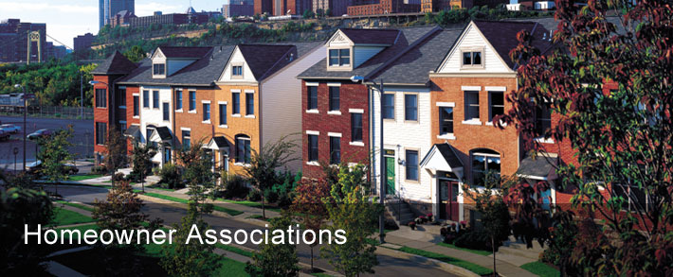
4
Case studies in a nutshell
Building management
Management and maintenance of the Slovak housing stock
Developing energy efficiency traditions in the Estonian
housing sector
Energy-efficient housing pilot project in Lithuania
Energy-efficiency enhancement as a result of
professional property management in Latvia

Slide 7
5
Case studies in a nutshell
Financial mechanisms
Allowances to low-income people to compensate renovation costs
Subsidies for technical expert examination and
energy audit of residential buildings
Subsidies for apartment building renovation depending on level of energy savings
Loans originated by state financial institutions

Slide 8
7
Key messages and transfers for transition countries
Recommendations from the casebook address social, environmental, economic, legislative, financial and technical instructions in the view of attaining holistic sustainable development in developing countries.
For example, the casebook offers messages regarding:
Political will and commitment
Public awareness about energy consumption
Residents control over their energy bills
Renovation targets
Alternative to building renovation
Costs of energy efficiency
Bankable investments
Managing buildings
Support measures at the transition period

Slide 9
Ongoing activities – capacity building
Workshops on energy efficient and affordable housing in Albania, July 2014
Energy efficiency sessions as part of annual workshops, 2014-2016
Armenia,
Republic of Moldova,
Serbia and
Tajikistan
as a part of the UNECE - UN-Habitat UNDA project
A regional workshop on energy efficiency in housing during the Fifth Energy Forum (in cooperation with the Sustainable Energy Division), 4 – 6 November 2014, Tunisia
Exhibition “Greener and smarter homes: energy efficiency in buildings”, 15 September – 10 October 2014

Slide 10
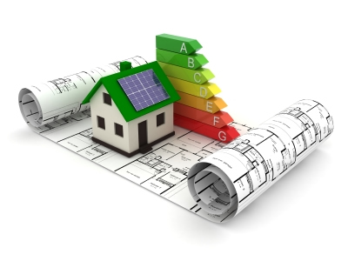
Planned activities – a study on building codes and standards with a focus on energy efficiency
A proposal for developing a study on standards (ECE/HBP/2014/4), which has been adopted by the 75th session of the Committee
Establishment of a UNECE Task Force (as an informal network of experts) on building codes and standards related to energy efficiency in buildings, including manufacturing of building materials and energy performance requirements

Slide 11
Expected outcome of the study on building codes and standards with a focus on energy efficiency
The launching of work on standards for energy efficiency in buildings, to include at least one standard that is also related to the use of building materials
The identification of other possible standards for sustainable buildings, beyond energy efficiency, and as identified by the expert group. These could include standards for the resilience of buildings to natural disasters and other construction codes to support smart cities, healthy and barrier-free housing.

